Slide 1
Software engineering assignment
By Paul Dinesh (10515229)
Arden Dias (10510105)

Slide 2
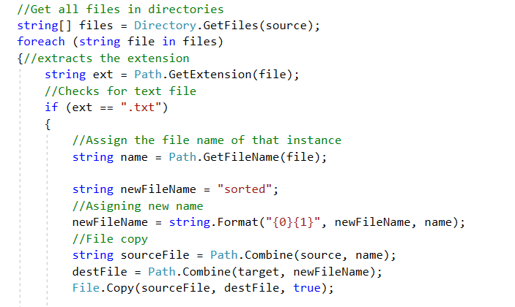
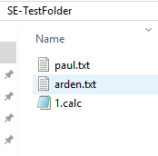
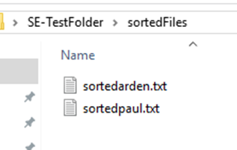
File copy
Loop runs for all the files
Checks for .txt
File.Copy (source,destination)

Slide 3
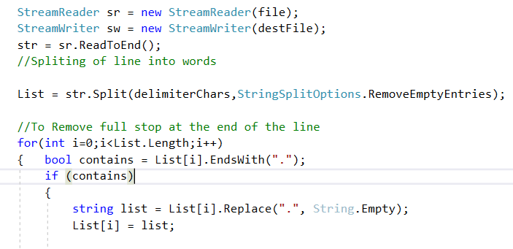

sorting
Reads all content from file
Splits based on delimiters such
as spaces
Removes full stop at the end of the line
Sorting is done by Array.Sort method

Slide 4
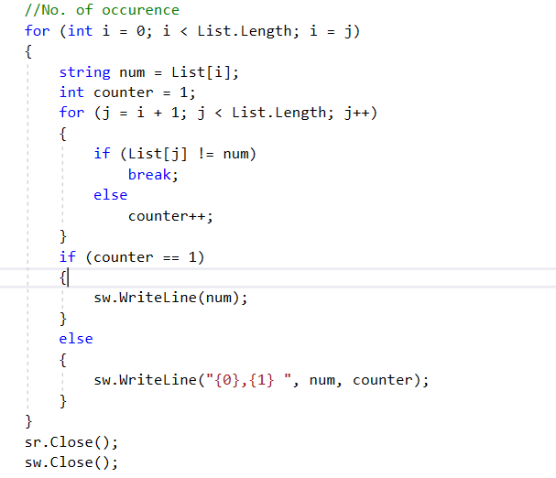
occurrence
An element of array is searched to count no. of occurrence.
When the element is found more than once counter variable is incremented
The element along with the occurrence are written in the sorted file

Slide 5
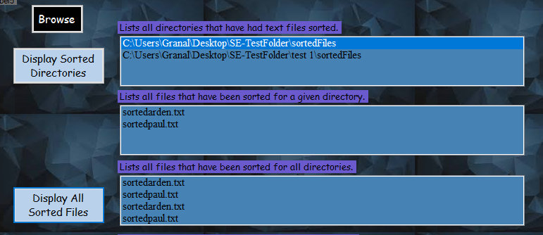
Listing
List all directories that have had text files sorted.
List all files that have been sorted for a given directory.
List all files that have been sorted for all directories.

Slide 6
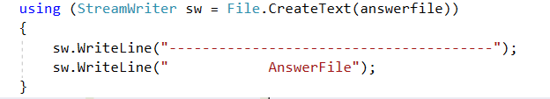
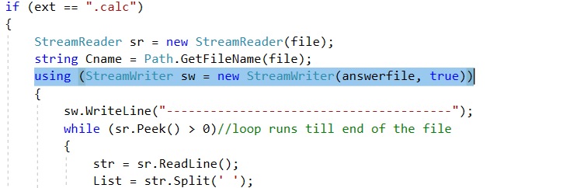
Creating file
New file is created using File.CreateText
Checks for calc extension
The contents from the files are read and
Stored in List Array

Slide 7
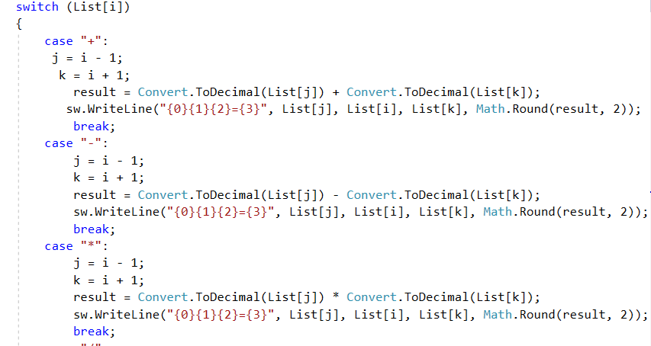
Checks for operators
Switch case(Operator)
Case(+)
Case(-)
Case(*)
Case(/)
Case(%)
Case(^)

Slide 8
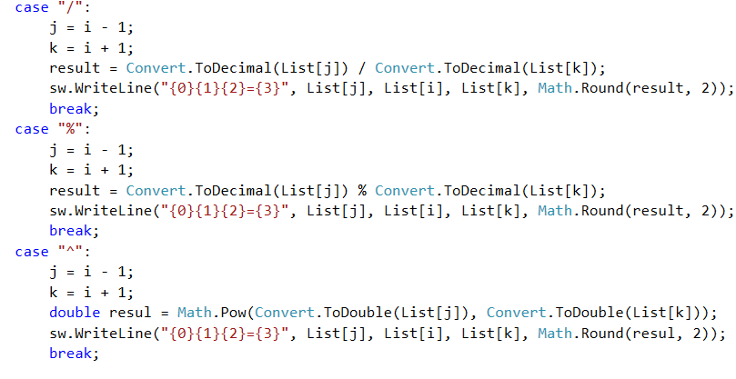
Performs calculation

Slide 9
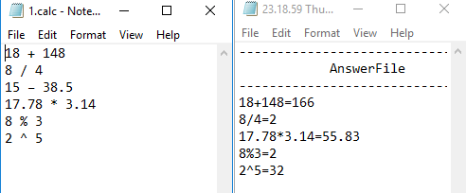
Writes to answer file
The arithmetic expressions are solved and the results are written in the Answer file with the new file name of current date.

Slide 10
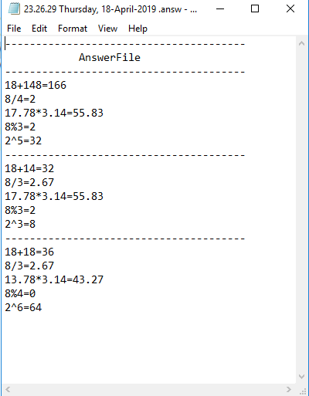
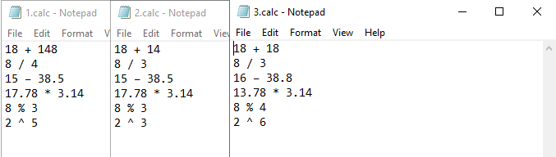
Input Files
Answer Files

Slide 11
Thank you!

